Slide 1

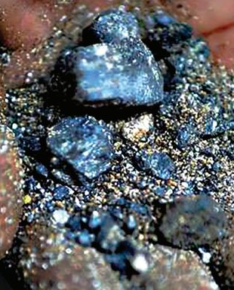
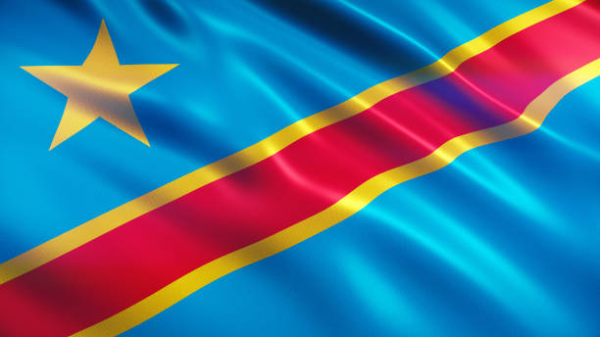
The Impact of Cobalt Mining on the Wellbeing of the Democratic Republic Of Congo
Kaleb Robertson
Syracuse University MPA 22

Slide 2
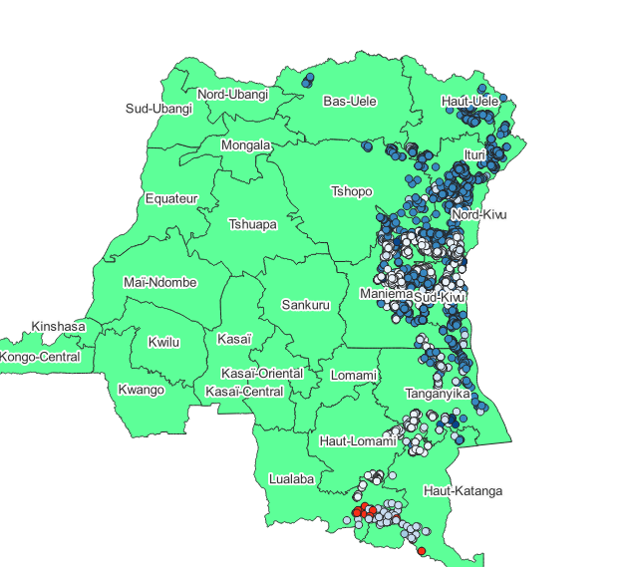
Why looking at Cobalt in the DRC?
Map of ASM Mines
Climate Change Solutions Globally
Habitat Concerns
Locally
Child Labor
Economic Development
Cobalt mines

Slide 3
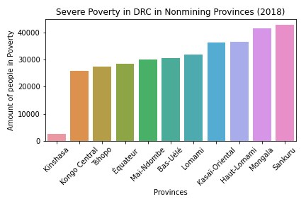
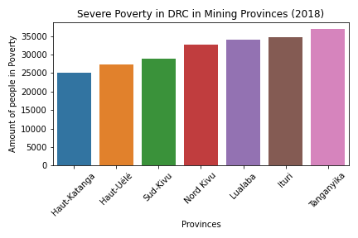
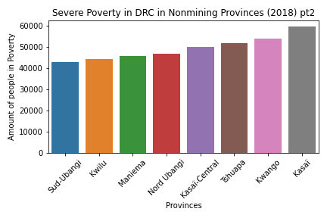
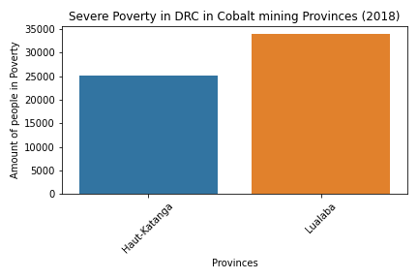
Severe poverty by Province
Average Amount of People in Severe Poverty
In All Mining Provinces: 31,317,460
In Non-mining Provinces: 38,440,940
In Cobalt Mining Provinces:29,485,450

Slide 4
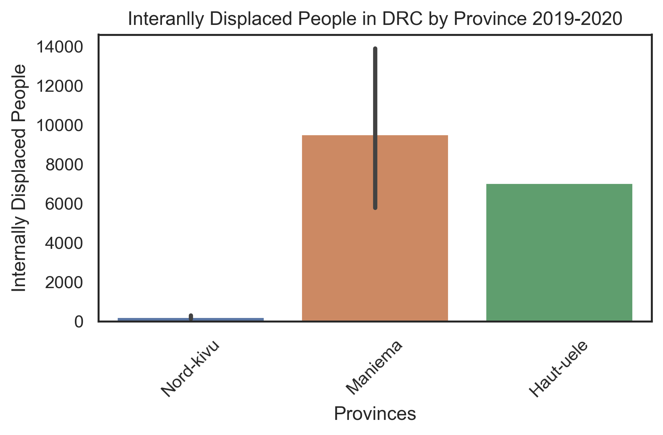
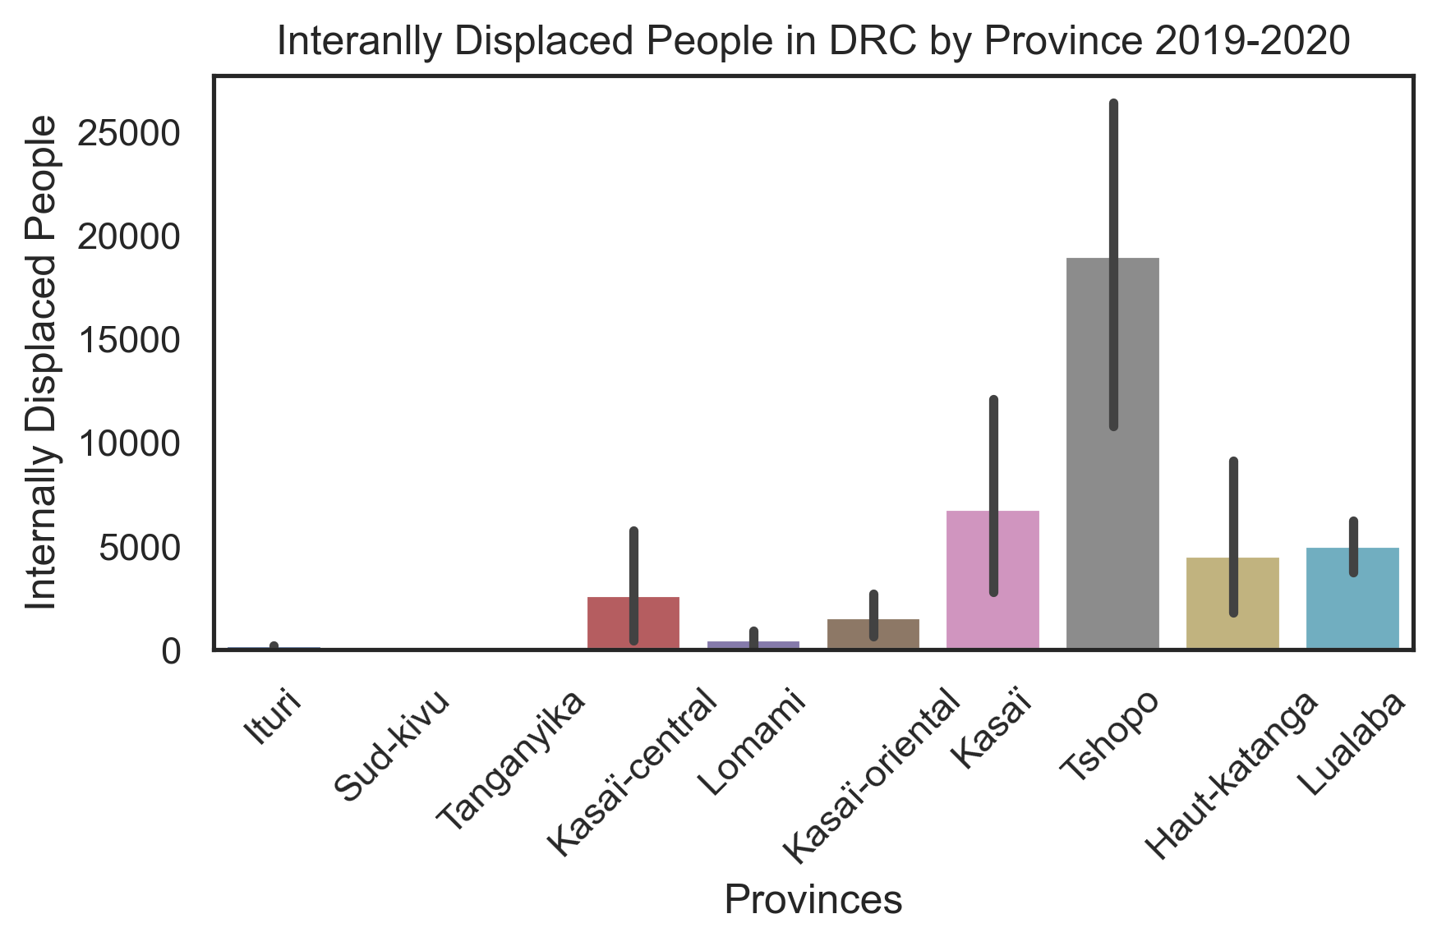
Conflict in Provinces
Conflict is almost solely focused in East DRC
Total amount of Internally Displaced People: 5,602,784
This does not include the amount of Internally Displaced People before 2019

Slide 5
Conclusions
Findings:
Mining, especially Cobalt Mining, shows a positive relationship with economic Security
These benefits are also present even with higher rates of conflict
Suggestions:
ASM formalization should be pursued, banning mining immediately would devastate the DRC
ASM Formalization may reduce conflict based on unregulated competition in mining

Slide 6

Thank You!

